Slide 1
P
R
O
F
I
T
I
L
O
S
S
K
Predicting Stock Market’s Trend
What trend will the biggest 500 public companies take?
Juan Zambrano

Slide 2
P
R
O
F
I
T
I
L
O
S
S
K
Problem:
What trend will the largest 500 public companies take in the stock market?

Slide 3
Why is it important to know?
Stock Market
Refers to the collection of exchanges and other venues where the buying, selling, and issuance of shares of publicly held companies take place
SPY
Ticker that represents an Exchange-Traded Fund (ETF) that tracks the Standard and Poor's 500. Includes the biggest 500 companies in the United States stock market.
Economy
The stock market is one of the biggest representations of the economy. Think of it as an outlook of the publicly traded companies.
Retirement
If you are employed, you have probably heard of 401k. Your retirement is invested in the market and hopes to grow overtime.

Slide 4
Project Structure
Data
Apply
Analyze
Conclude
Obtain Data
Apply Data Mining
Analyze Results
Determine a conclusion
Retrieve Data from Yahoo Finance ranged from January 23, 2012, to February 23, 2022
Utilize Data Mining methods in order to create the most accurate and effective logarithm
After running our Linear Regression, KNN, and Time Series. Identify the best model and use it to predict.
Conclude the analysis by predicting an outcome to our problem

Slide 5
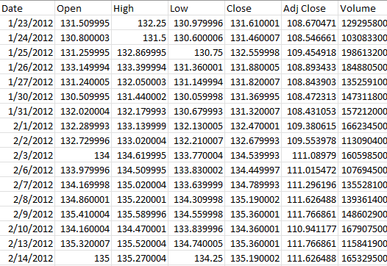
Data
$SPY

Slide 6
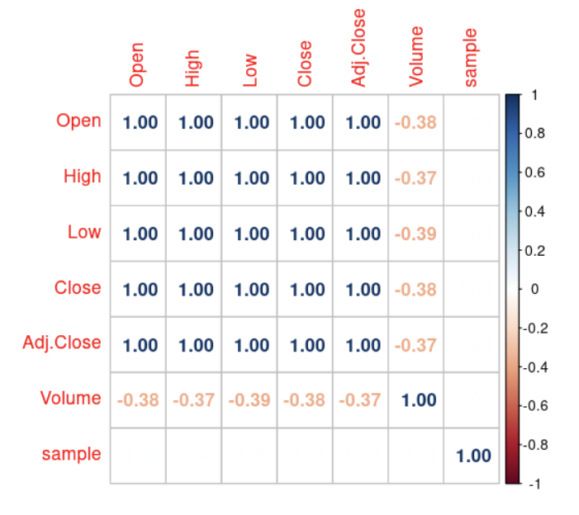
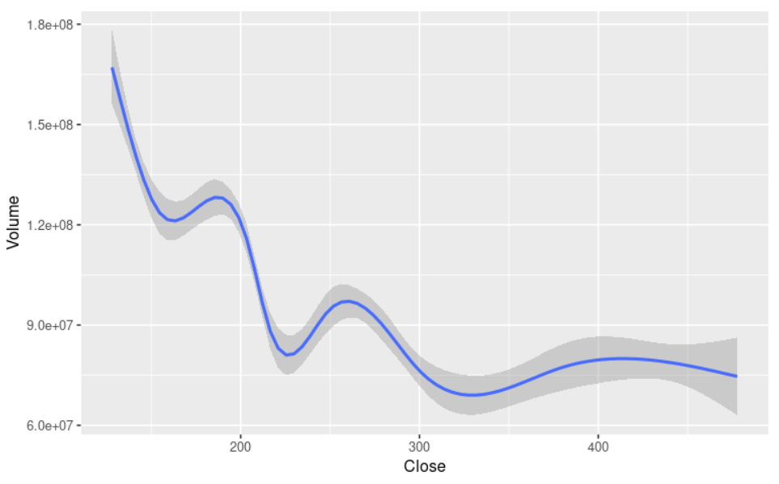
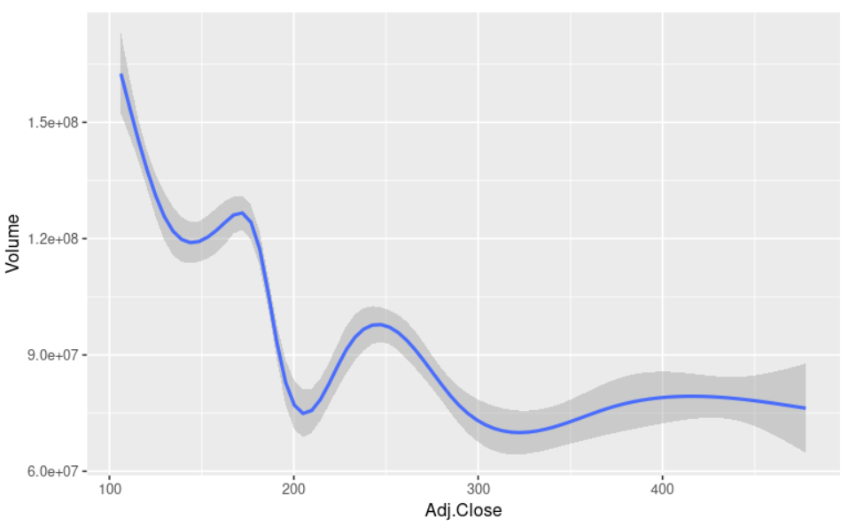
Data
$SPY

Slide 7
Apply: Linear Regression
 | Linear Regression
 | RMSE: 0.9839
 | Close*
 | Volume
 | Open
 | High
 | Low
 | Adj. Close
 | Stepwise Backwards
 | RMSE: 0.9839
 | Close*
 | Volume
 | Open
 | High
 | Low
 | Adj. Close
 | Stepwise Forward
 | RMSE: 0.9839
 | Close*
 | Low
 | Stepwise Both
 | RMSE: 0.9839
 | Close*
 | Volume
 | Open
 | High
 | Low
 | Adj. Close

Slide 8
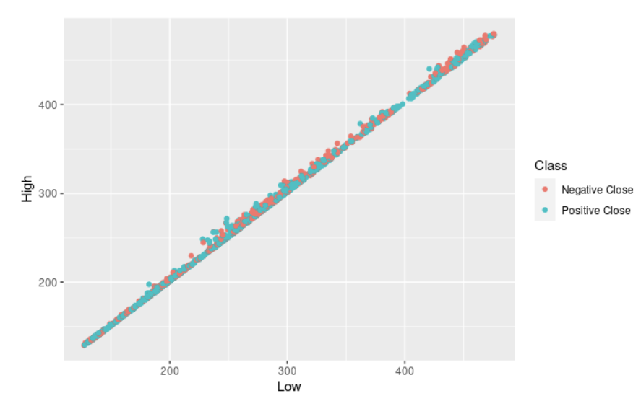
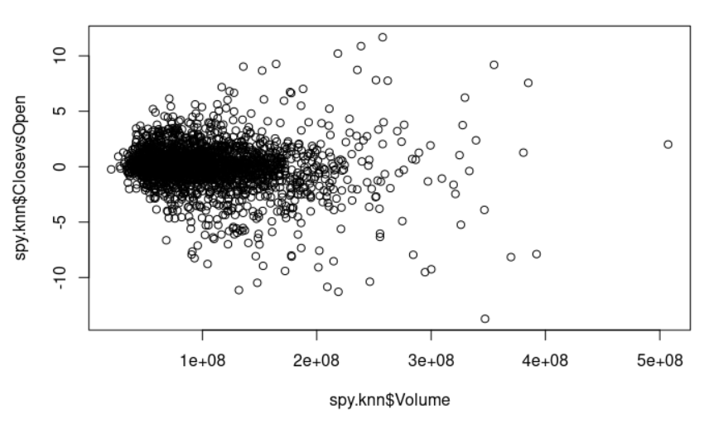
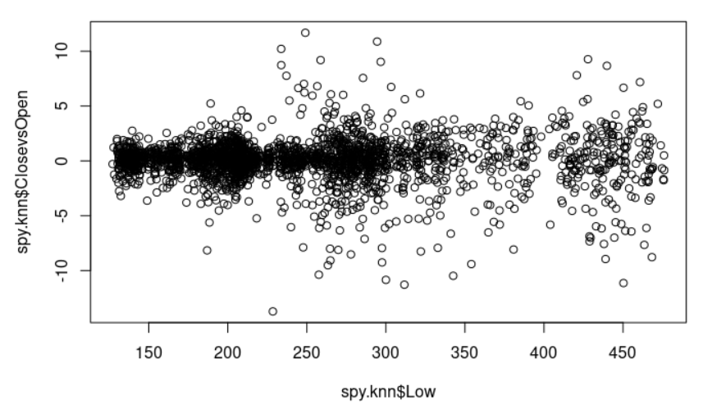
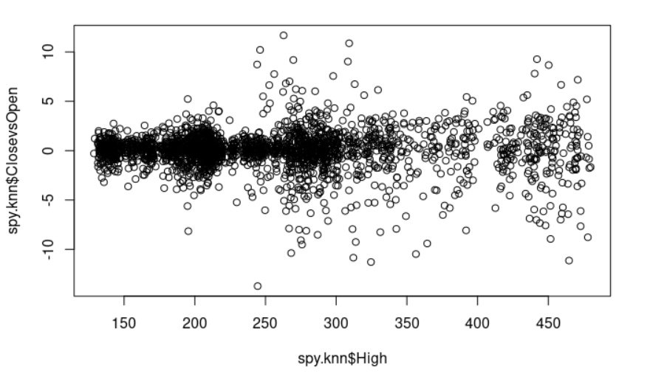
Apply: K Nearest Neighbors
Creating a Class: Positive Close & Negative Close
*
A new classification was created spotting the difference between Close and Open looking to a negative or positive close.
Visualizing Correlation
*
Looking at best classifiers for our data, it was looked at correlation of most relevant variables against Close vs Open.

Slide 9
Apply: K Nearest Neighbors
Model 1
Model 2
Low
High
Open
Close
50%
83%
Model 1
Model 2

Slide 10
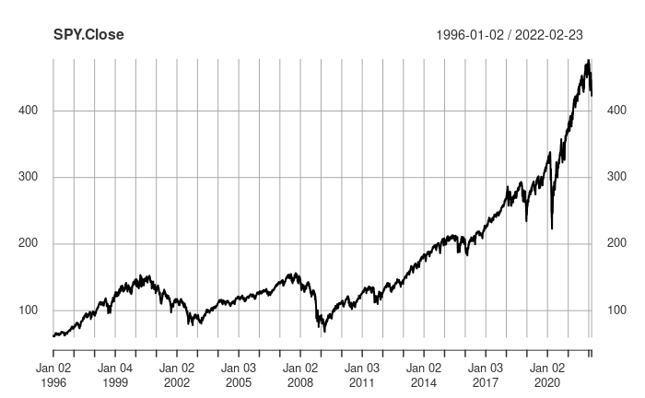
Apply: Time Series
Date and Final Price (Close)
Reduced data to only reflect Date and Close
Created two Arima Models
Utilizing Auto Arima (2,1,3) with a drift and Custom Arima of (1,1,1)
You can simply impress your audience and add a unique zing and appeal to your Reports and Presentations with our Templates.

Slide 11
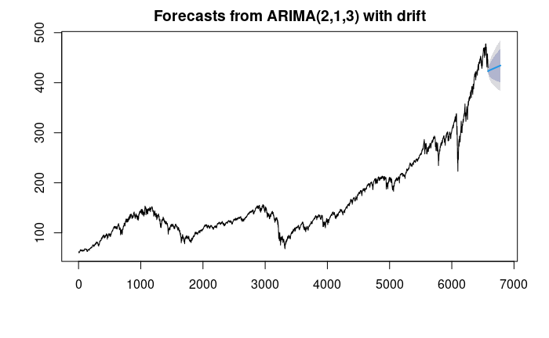
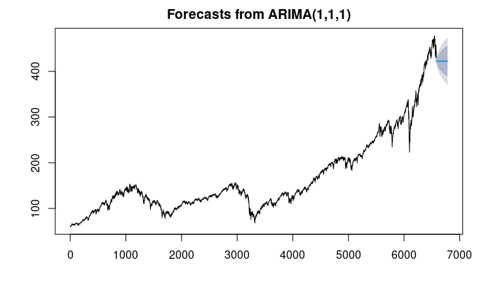
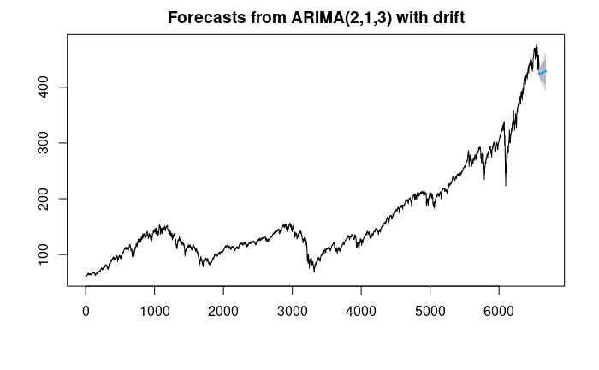


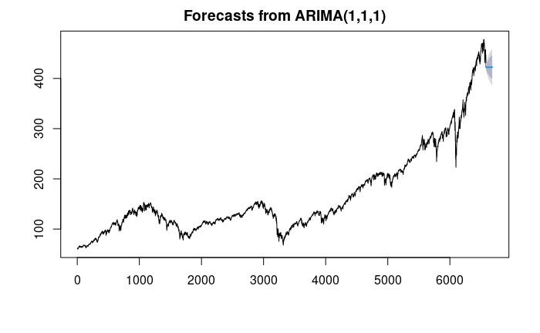
Apply: Time Series

Slide 12
Conclude: Outcomes
Our data is best
Utilized in models that can account for time as we would like to predict trends
Time Series
Fitted best with our data as can handle dates and numeric values such as Close
Auto Arima
Showed a strong uptrend in the 200- and 365-days forecast
Custom Arima
Showed a sideways trend in all three timeframes.
Final Comments
Time series model showed that the recent downtrend in the market may be transitory and that we are to maintain our trend or go in an uptrend from here and on. This would represent a good time to buy securities as the risk may only be low.
BUY

Slide 13
P
R
O
F
I
T
I
THANK YOU
L
O
S
S
QUESTIONS?
K

